Slide 1

The OpenStreetMap Revolution
building community one node at a time
This document licensed in entirety by Creative Commons CC-by-SA. For specific terms of license, see: http://creativecommons.org/licenses/by-sa/3.0/

Slide 2
Overview
The Short History of the OpenStreetMap Revolution
Why OpenStreetMap has reached the tipping point
Why should you get involved?

Slide 3
The Origins of OpenStreetMap
OpenStreetMap.org domain registered by Steve Coast in 2004
Project originated in the United Kingdom, where…
Crown copyright on geospatial data
Little, or no public domain data
Simple goal to create a free, publicly-available database of street centerlines

Slide 4
OpenStreetMap is…
A freely-editable map of the world unconstrained by proprietary ownership
“Wikipedia for maps”

Slide 5
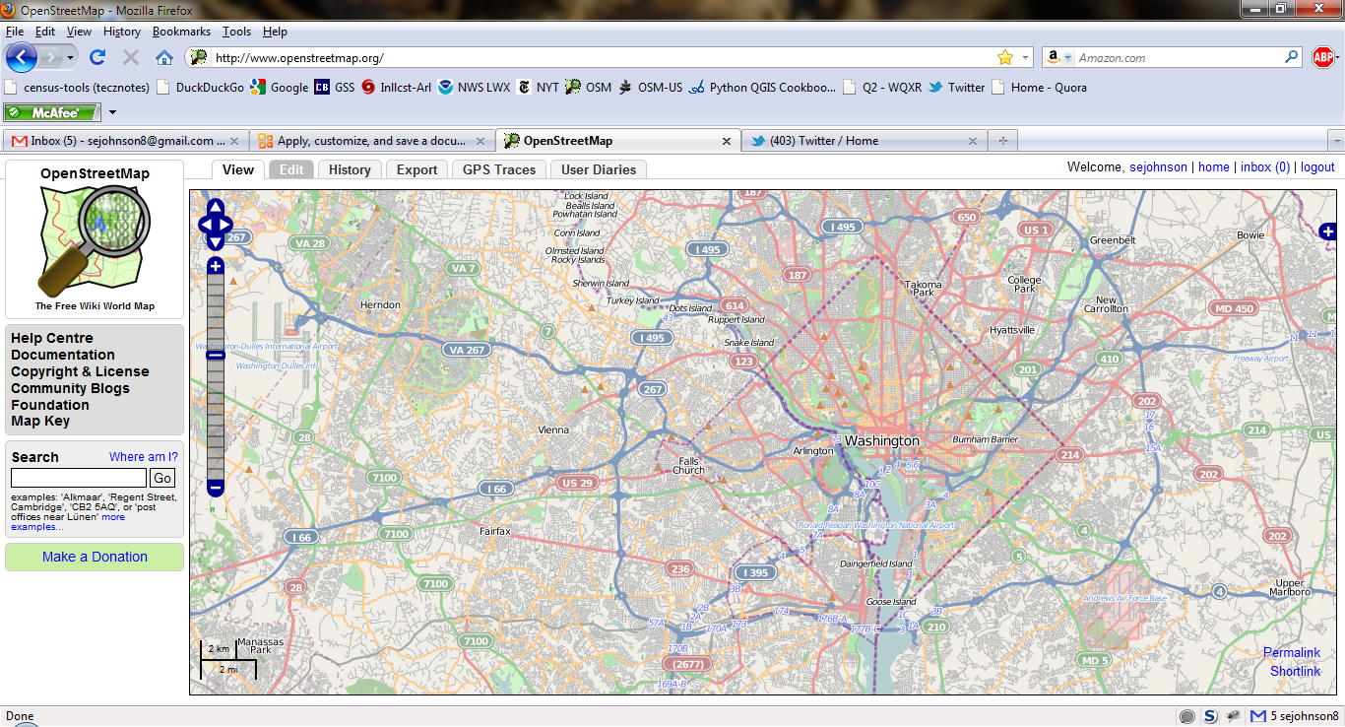
Looks like…a wiki

Slide 6
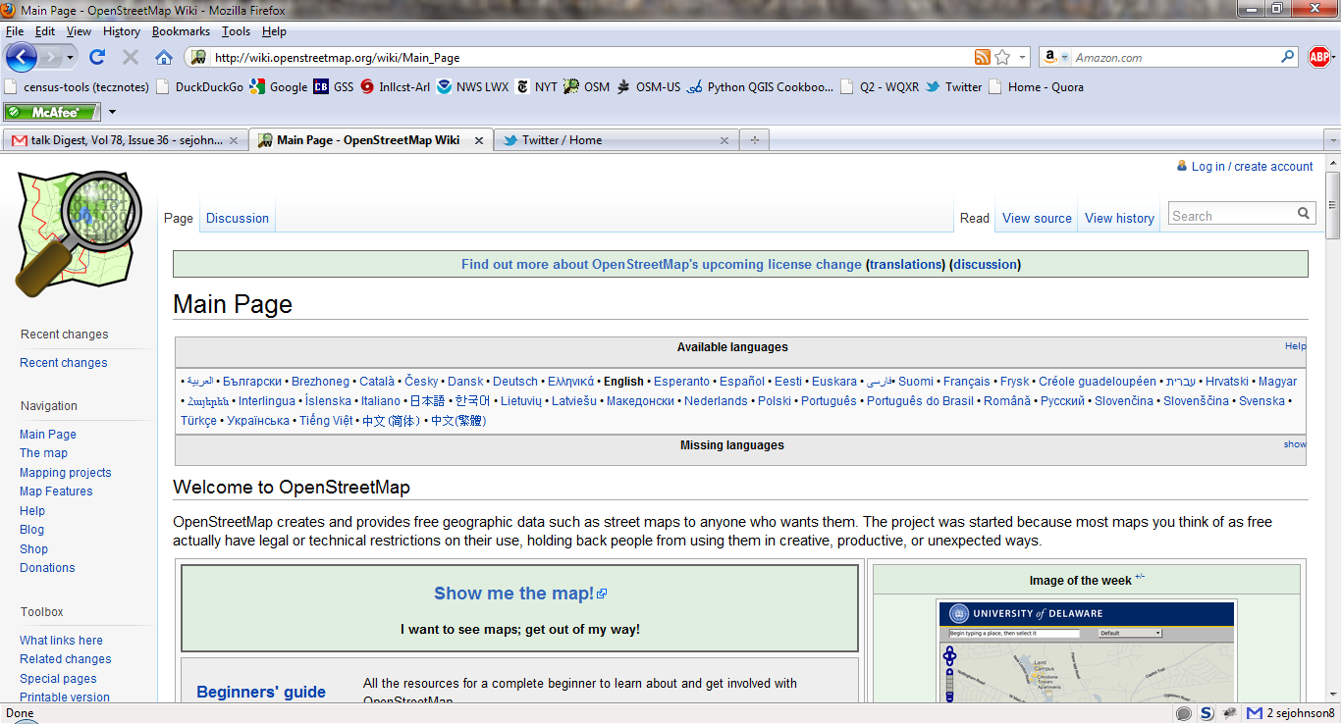
Wiki-based Documentation!

Slide 7
Milestones in OpenStreetMap History
2004 - OpenStreetMap.org registered by Steve Coast
2005 – Map Limehouse, 1st OpenStreetMap mapping party
2005 – 1000 registered OpenStreetMap users
2006 – OpenStreetMap Foundation established
2007 – 5 million ways in OSM database
2007 – 10,000 registered OpenStreetMap users
2008 - TIGER data import for the US completed
2009 - 100,000 registered OpenStreetMap users
2010 - 200,000 registered OpenStreetMap users
2012 – ~670,000 registered OpenStreetMap users

Slide 8
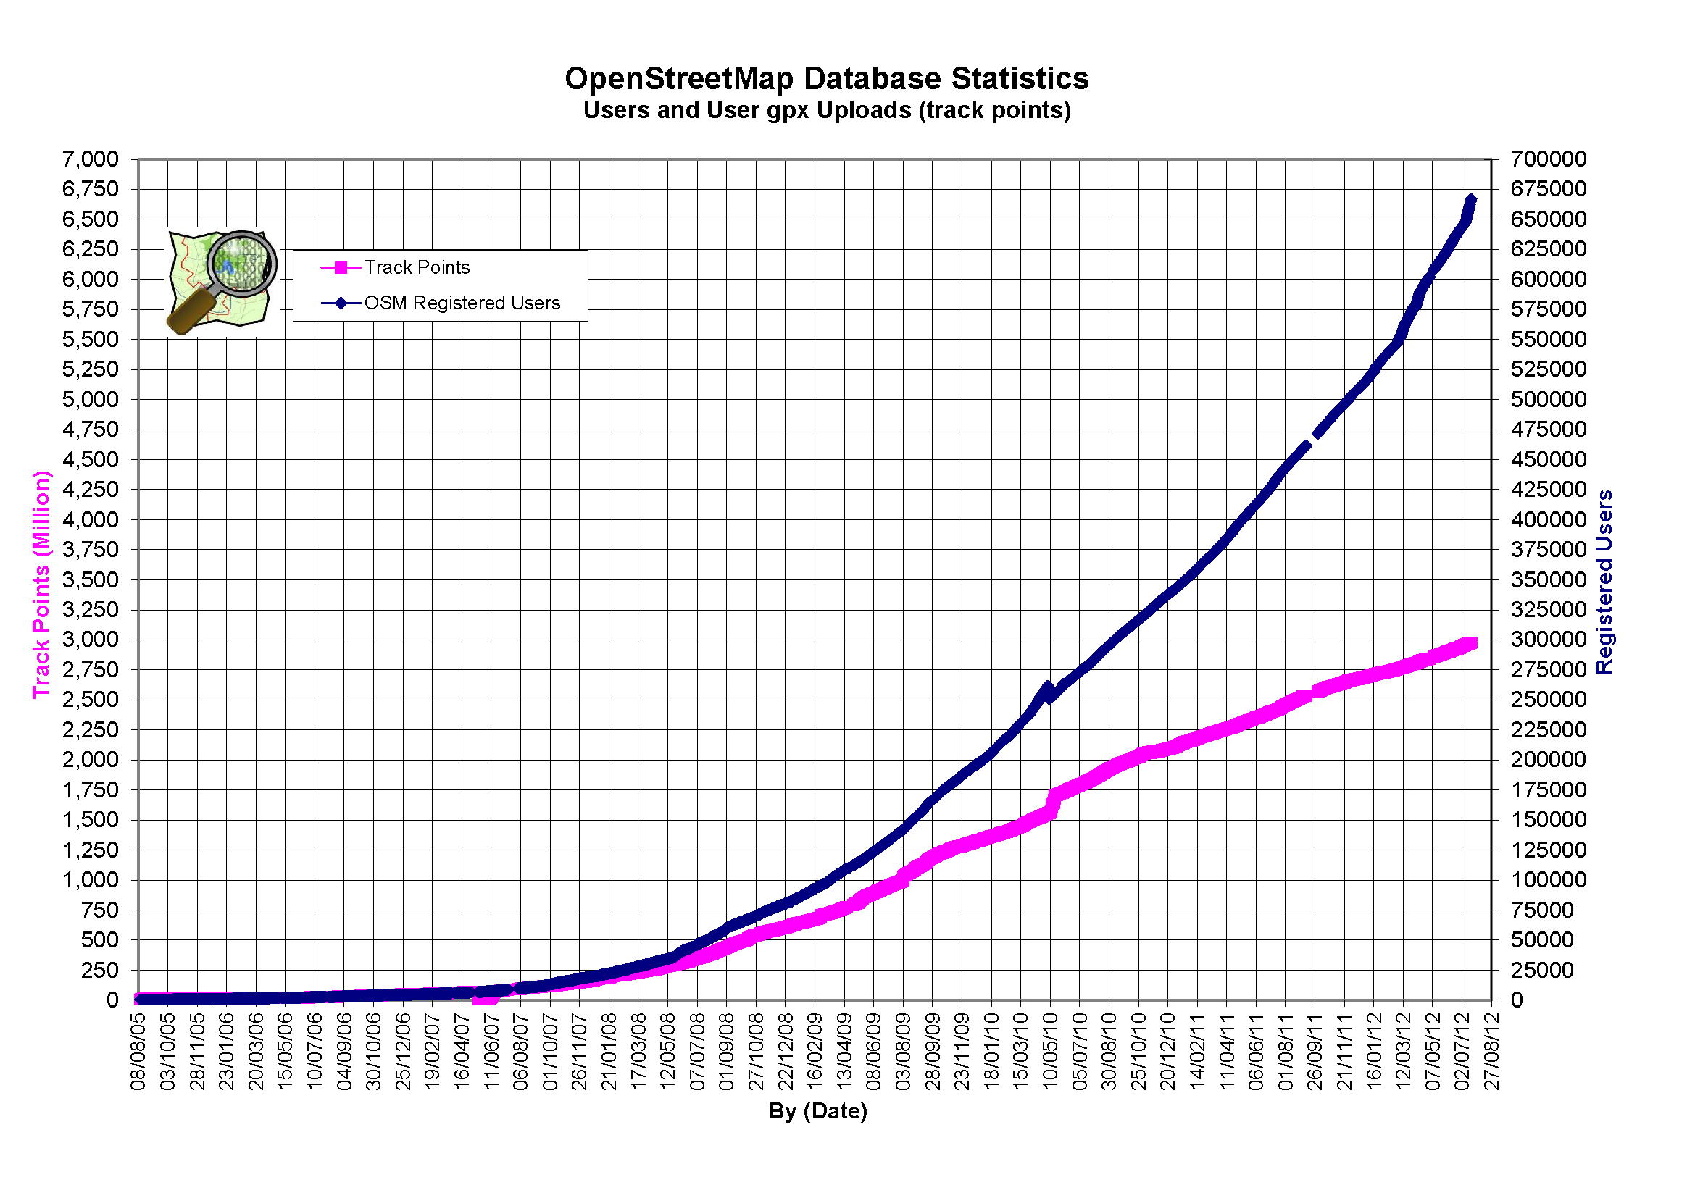
OpenStreetMap User Growth

Slide 9
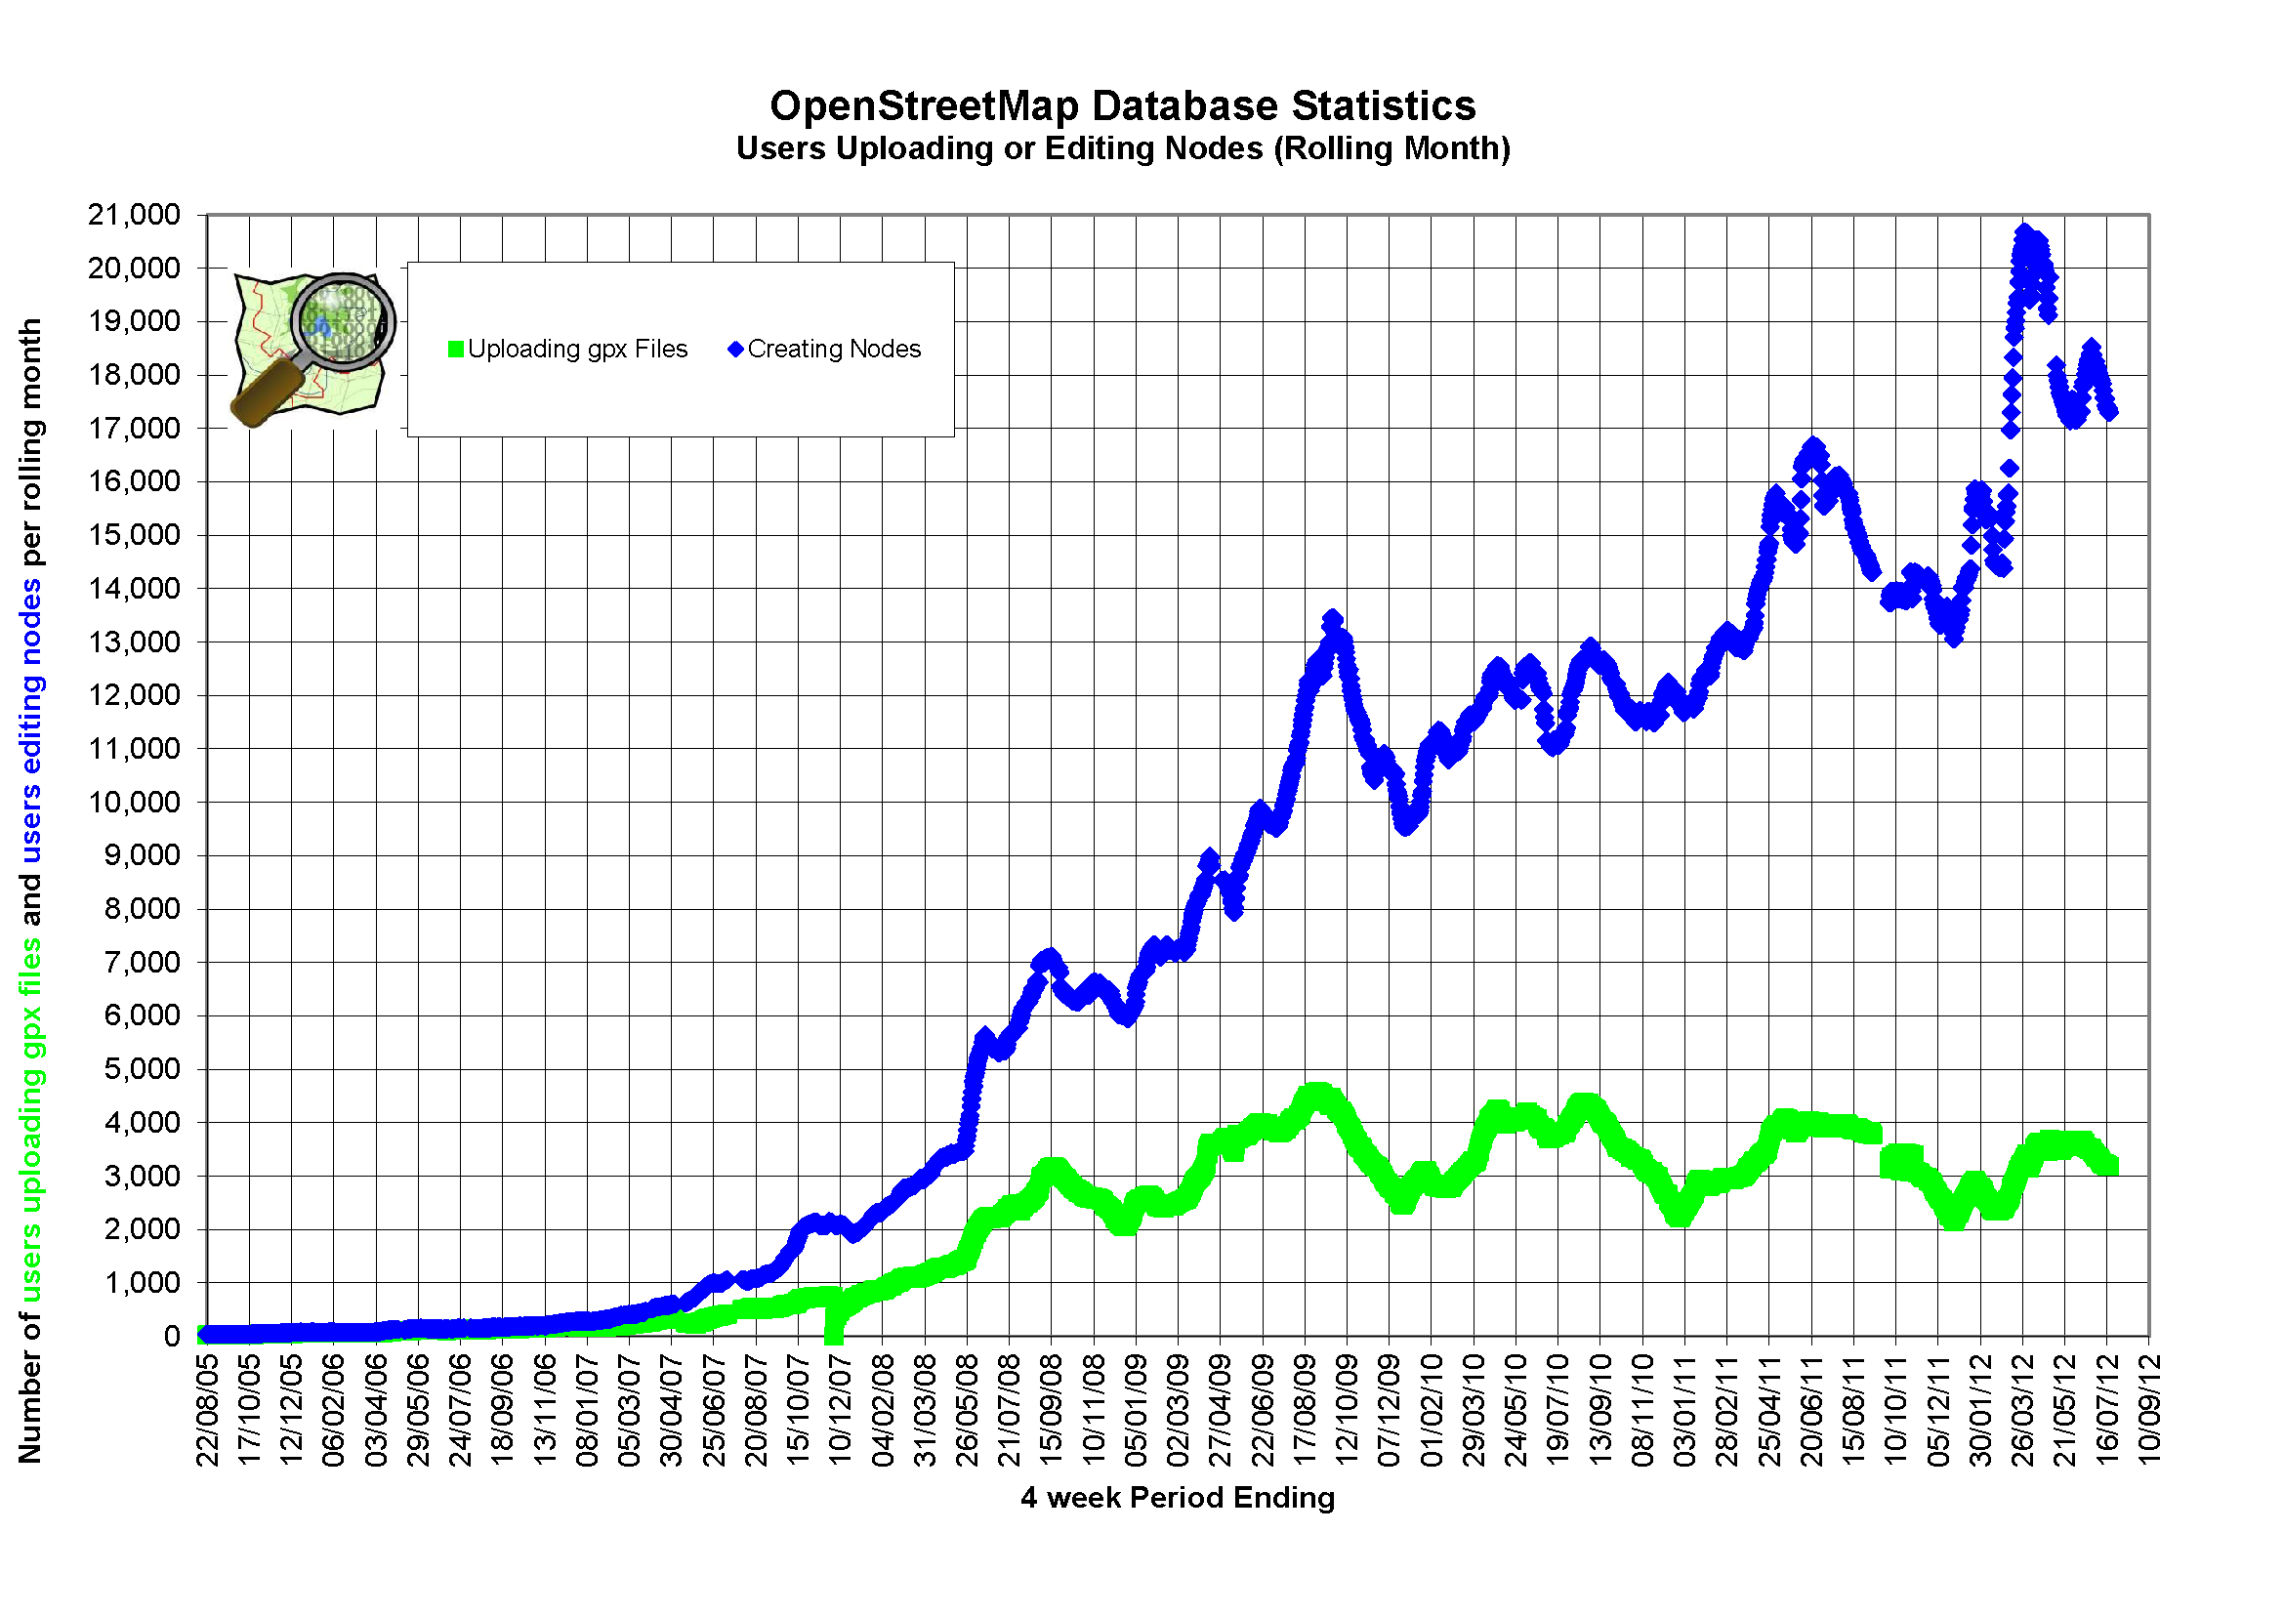
OpenStreetMap Growth in User Edits

Slide 10
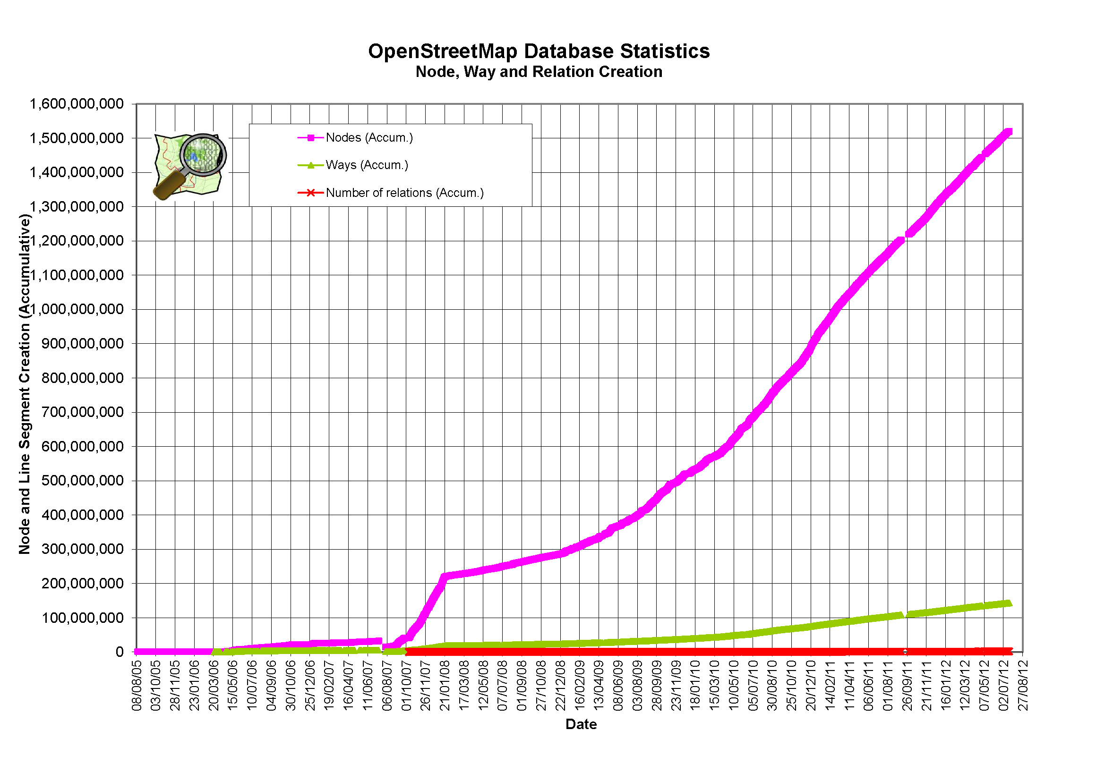
OpenStreetMap Database Growth

Slide 11
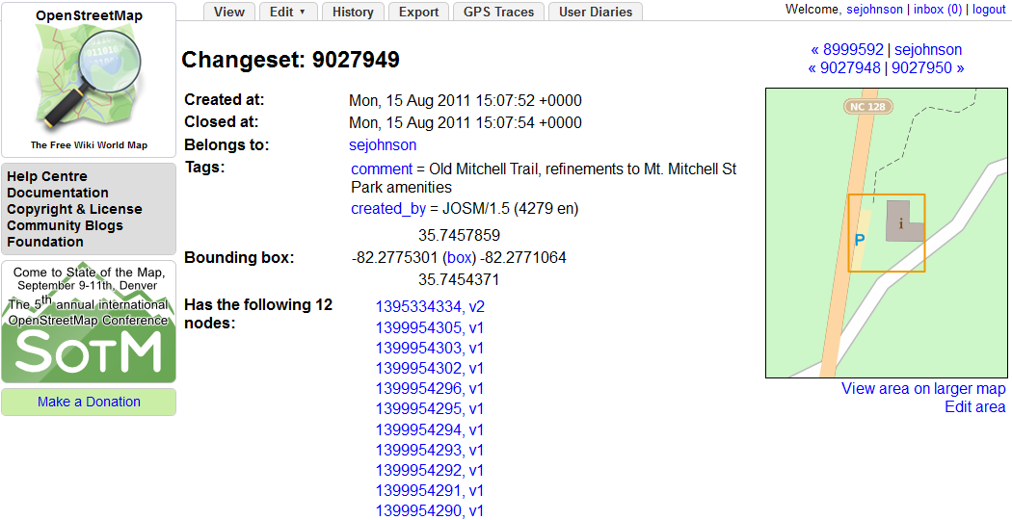
Data Model
Every edit is part of a Changeset

Slide 12
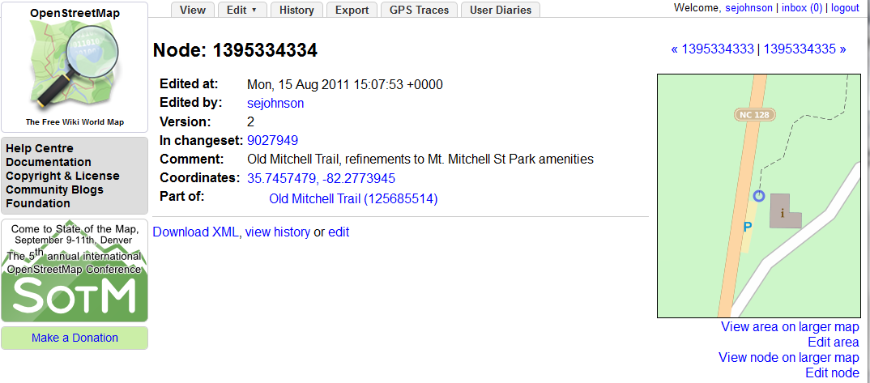
Data Model
Every Changeset is composed of Nodes

Slide 13
Data Model
Every node has an XML representation
<osm version="0.6" generator="OpenStreetMap server"><node id="1395334334" lat="35.7457479" lon="-82.2773945" changeset="9027949" user="sejohnson" uid="25398" visible="true" timestamp="2011-08-15T15:07:53Z" version="2"/>
</osm>

Slide 14
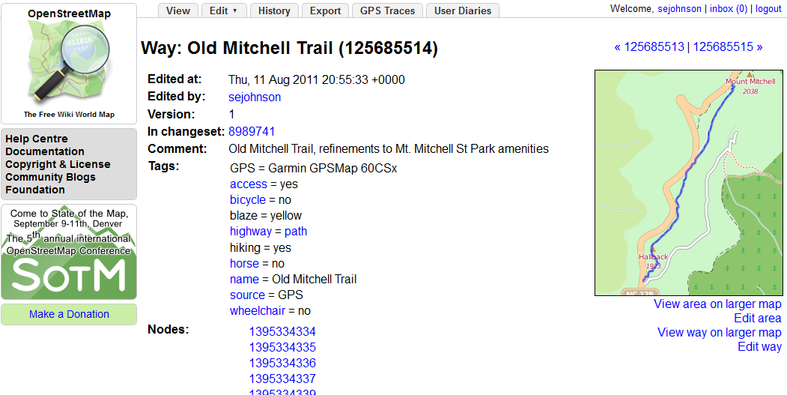
Data Model
Nodes are ordered into Ways

Slide 15
Q. Where did all this data come from?
Answer: Mapping Parties

Slide 16
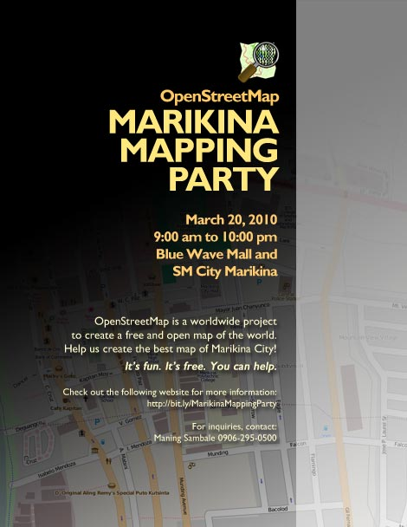
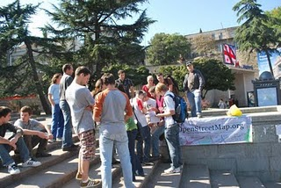
Mapping Party?
Informal get together
Do some mapping
Socialize & make friends
Make a free map of the world!

Slide 17
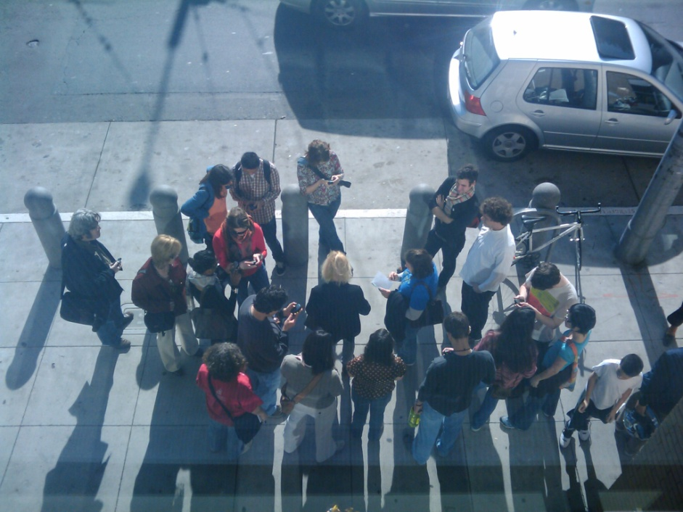
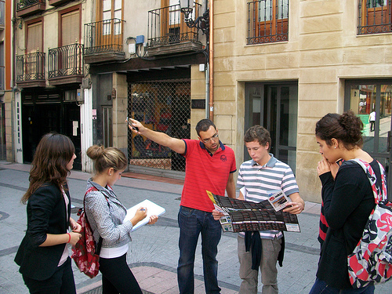
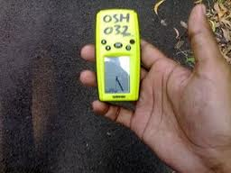
Mapping Party? Yes!
It’s a community event
Organized around mapping a local area
Collect Data
Upload and tag
Socialize

Slide 18
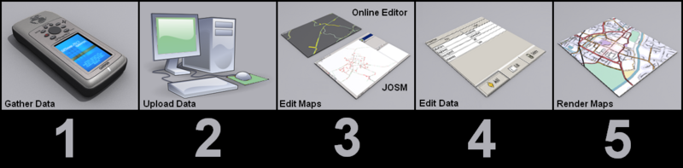
Mapping Party Workflow Overview
1 Gather data
2 Upload GPS tracks
3 Trace the features
4 Tag with attributes
5 View results
Source: http://wiki.openstreetmap.org/wiki/Map_Making_Overview

Slide 19
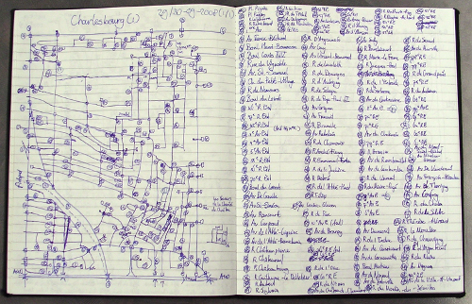
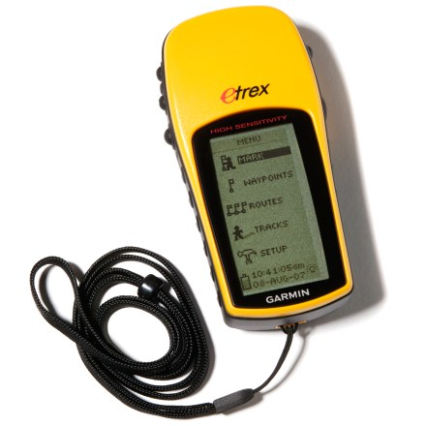
Step 1. Collecting Data
What features will you map?
Local businesses?
Street furniture?
Street trees?
Add addresses to building
footprints?
Local knowledge is a plus
Take notes in the field
Source: Frank’s Log Book http://weait.com/content/look-frank-log-book
Source: Garmin

Slide 20
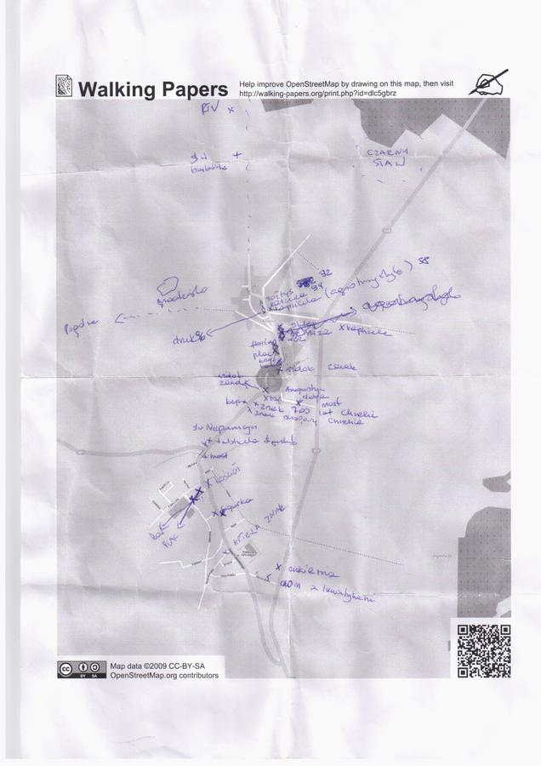
Step 1: Collecting Data: On Paper
Walking-papers.org from Stamen Design
Zoom to area of interest
Create .pdf
Print and use in the field.
Use heads-up digitizing and imagery to input data into OSM
Source: http://walking-papers.org/

Slide 21

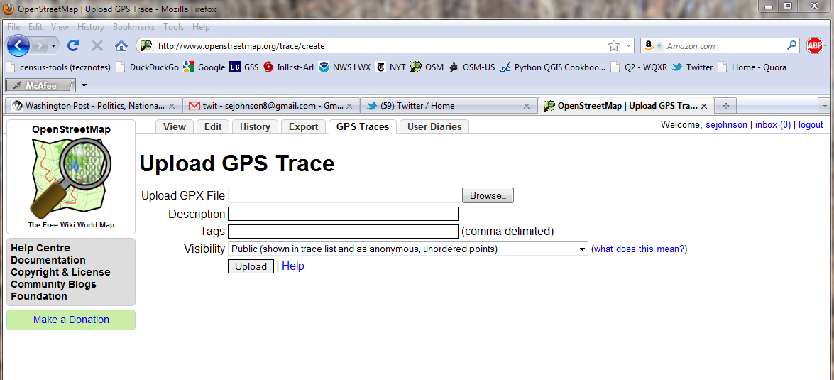
Step 2. Upload GPS data to OSM
Login to OSM
Copy data from GPS unit
Click ‘GPS Traces’ tab, then click ‘Upload a Trace’

Slide 22
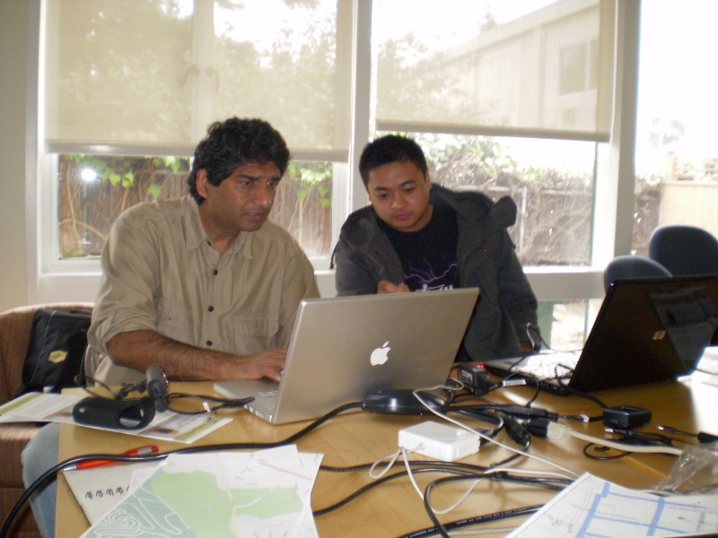
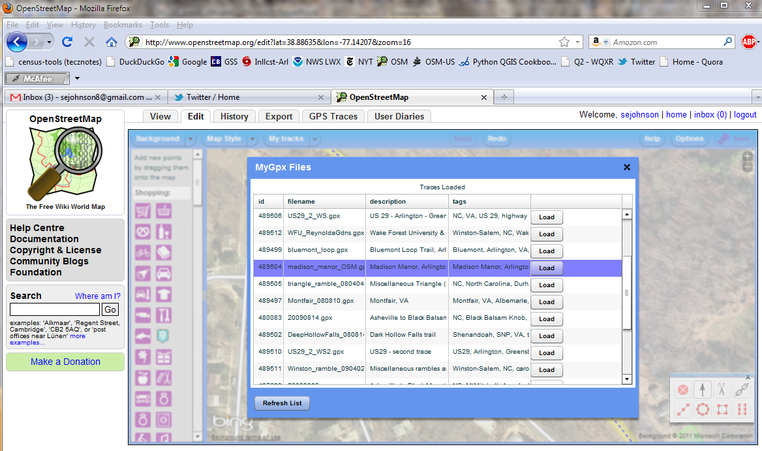
Step 3. Edit the Traces to Map Features
Use your favorite editor to trace the GPS tracks into OSM
Source: Cloudmade.com

Slide 23
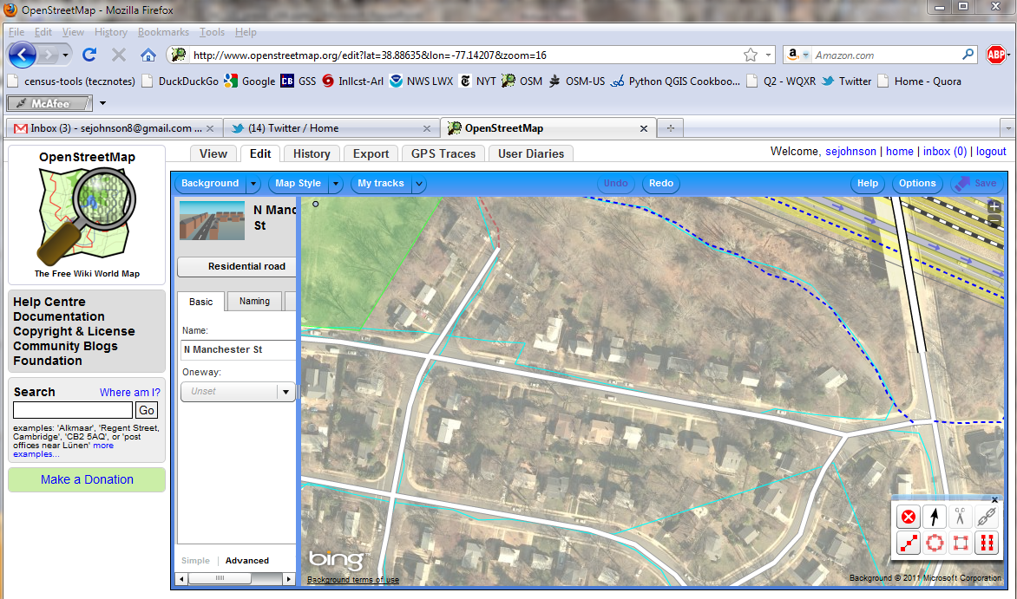
Step 3. Edit the Traces (cont’d.)
Imagery backdrop allows for smoothing of GPS data

Slide 24
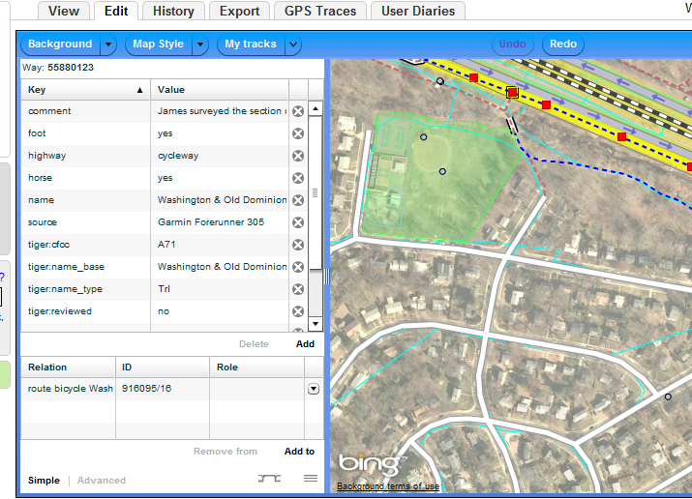
Step 4. Tag the Features to Add Data
‘Tag’ = ‘add attribute data’
Take the form of Key + Value

Slide 25
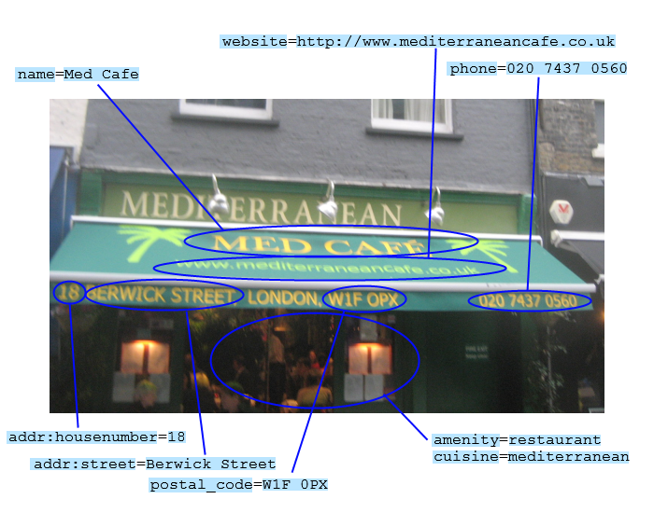
Step 4: Tagging (cont’d.)

Slide 26
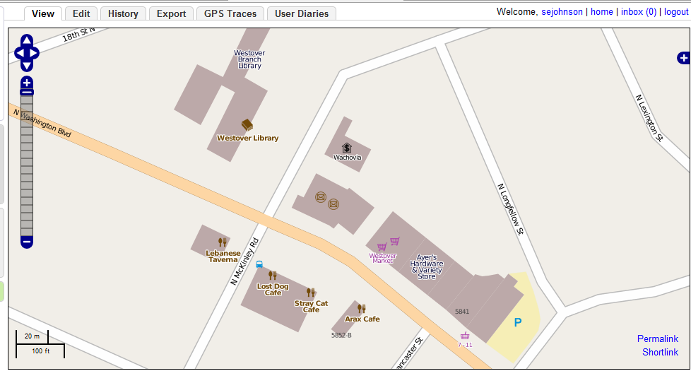
Step 5. Admire Your Work
Results usually available within an hour of uploading

Slide 27
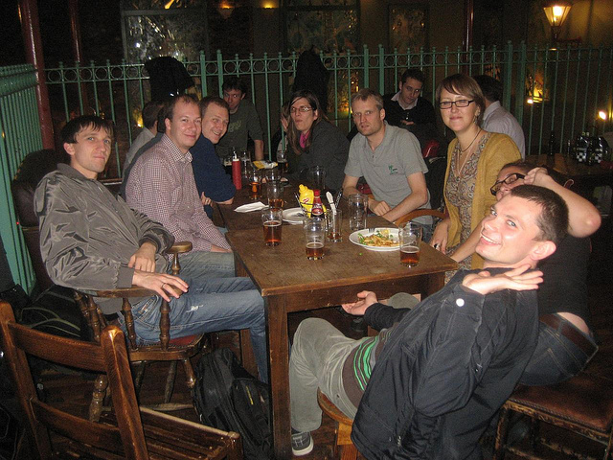
Adjourn to Mappy Hour!
Source: Flickr, user Harry Wood

Slide 28
Summary: Key Points about OSM
Established; 8 years of continuous growth
A community of +675, 000 users distributed worldwide
Maturing methods of data input, auditable RESTful data model
Increasingly comprehensive and useful

Slide 29
Why OpenStreetMap is at a Tipping Point
services built on OpenStreetMap

Slide 30
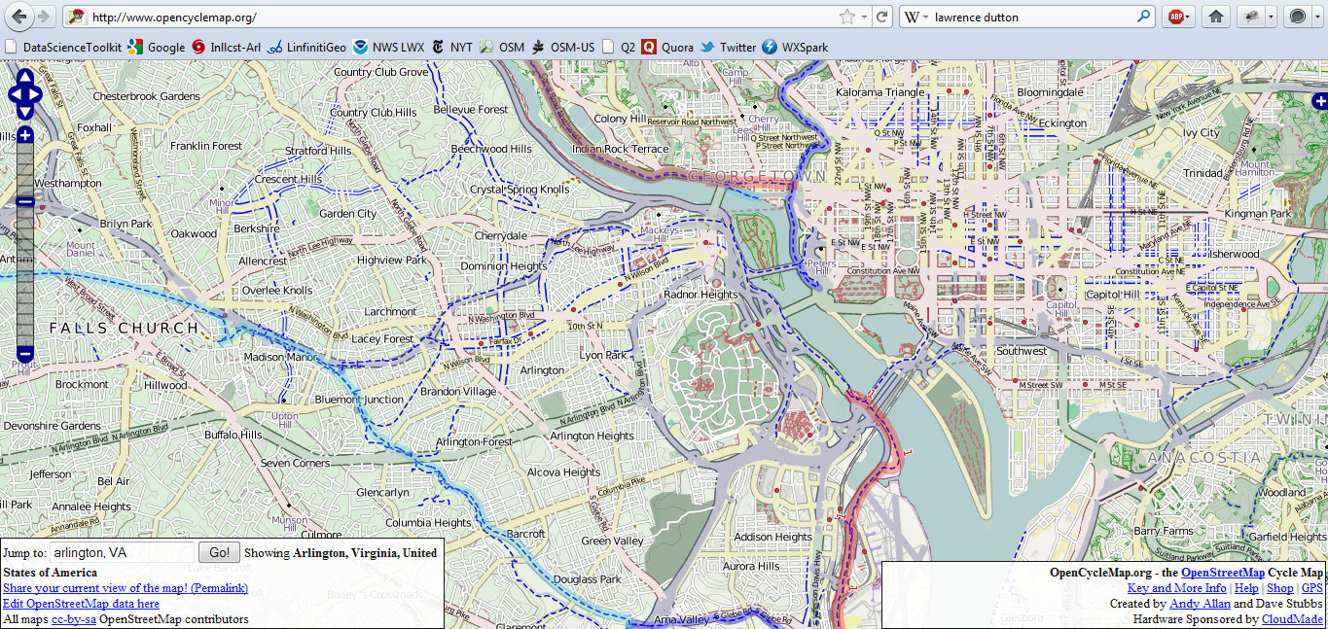
OpenStreetMap as a platform for services
OpenCycleMap – Map of Bicycle Routes

Slide 31
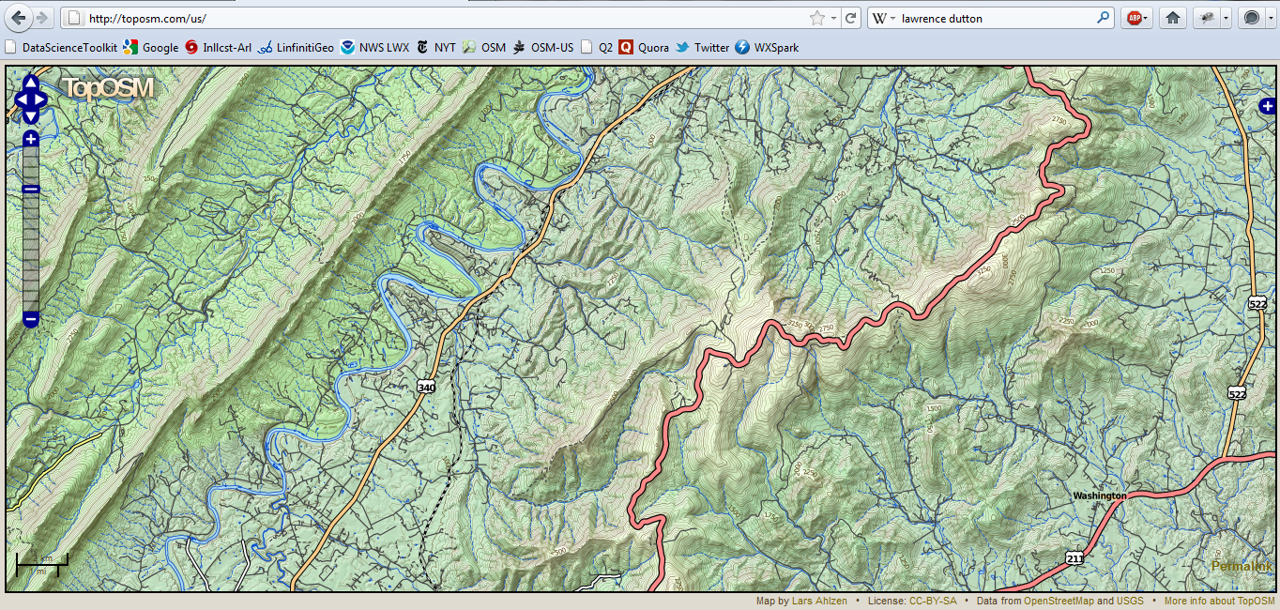
OpenStreetMap as a platform for services
TopOSM – Topographic OpenStreetMap

Slide 32
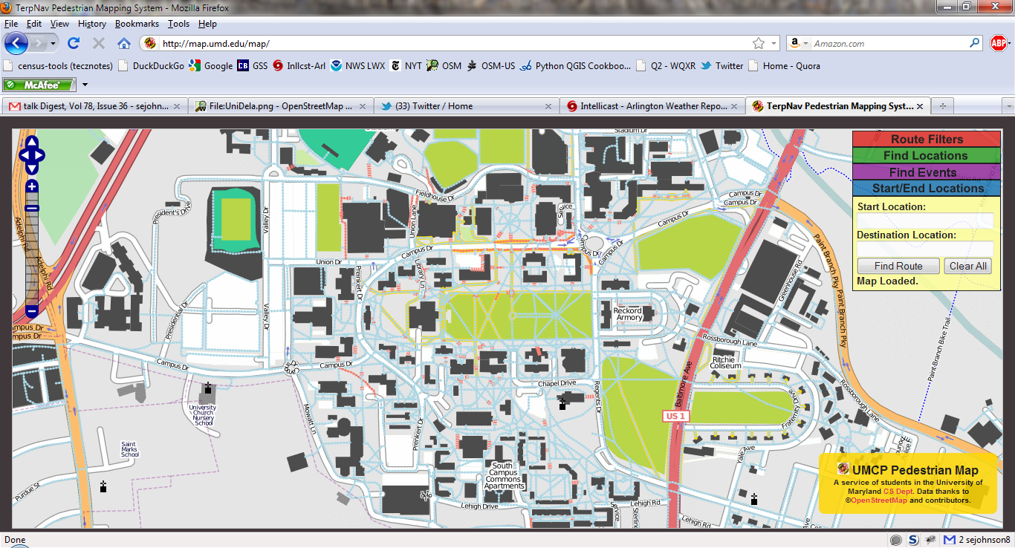
OpenStreetMap as a platform for services
University of Maryland Campus Map

Slide 33
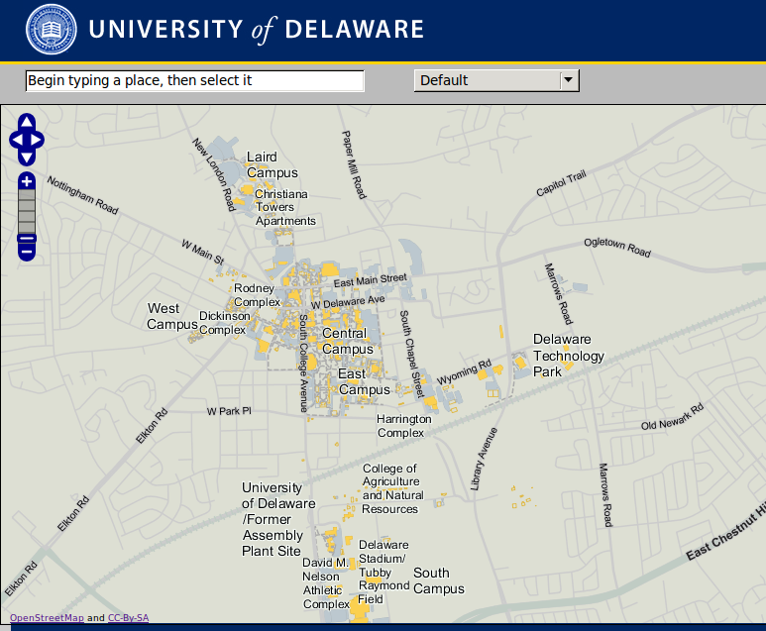
OpenStreetMap as a platform for services
University of Delaware on OpenStreetMap

Slide 34

OpenStreetMap as a platform for services
MapQuest Open Tools:
Names (Gazetteer)
APIs & SDKs
Tiles
Beginner’s Guide to OpenStreetMap
http://developer.mapquest.com

Slide 35
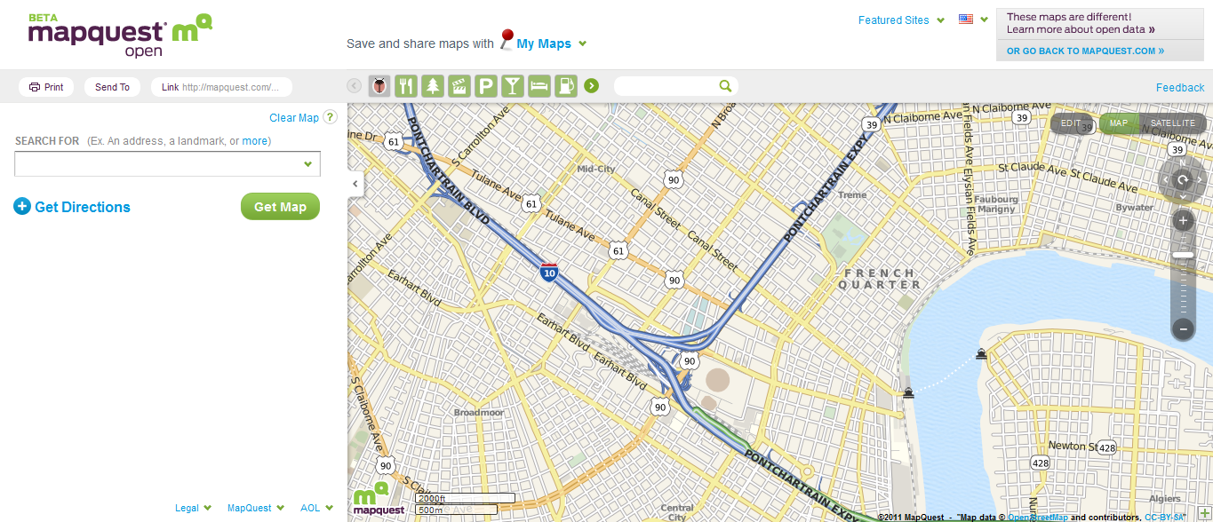
OpenStreetMap as a platform for services
MapQuest Open, using & editing OSM

Slide 36
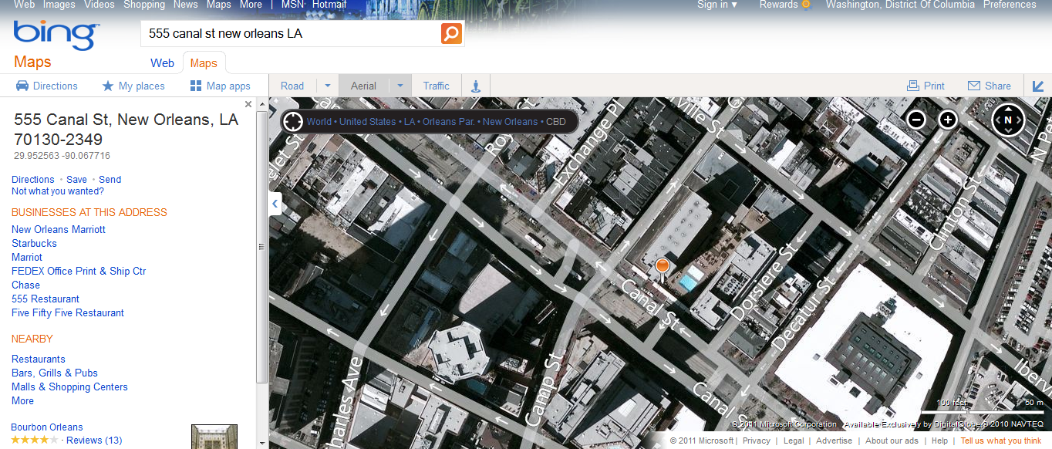
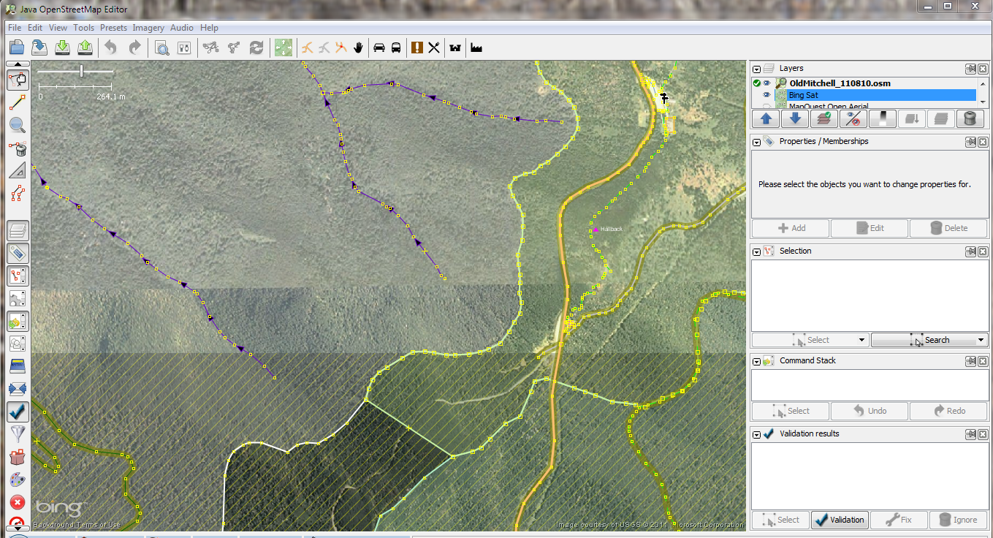
OpenStreetMap as a platform for services
Bing Imagery in Java OpenStreetMap Editor

Slide 37
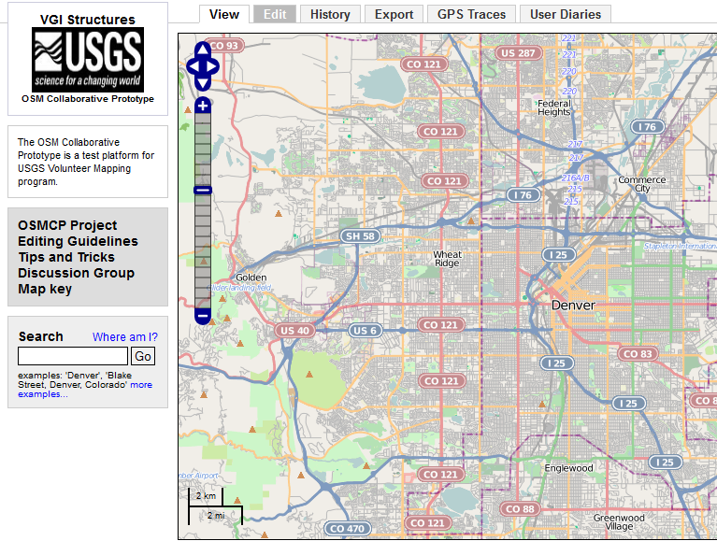
US National Map prototype
Can crowdsourced data meet or exceed standards for integration into National Map?
Test the OSM platform for use in National Map applications
Test decentralized platform to improve Federal data

Slide 38
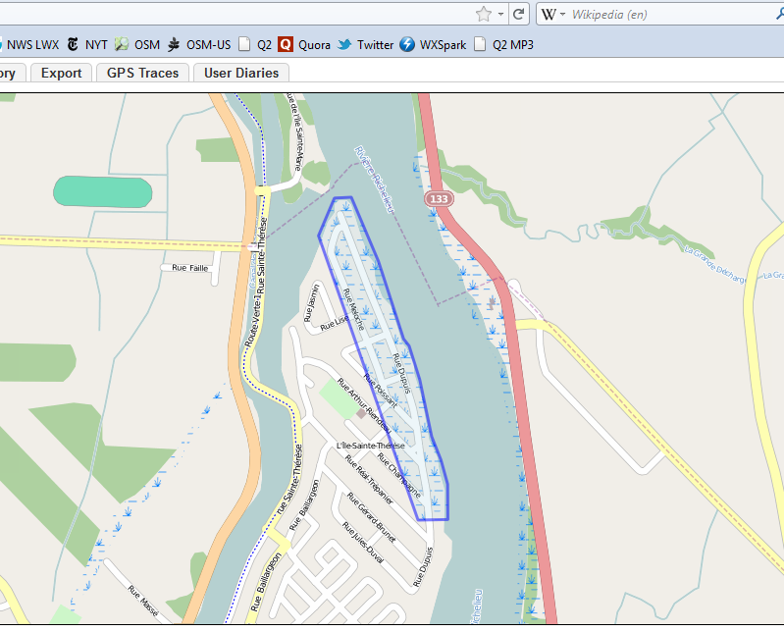
Humanitarian OpenStreetMap Team
Established after Haiti Earthquake 2010
Operates where maps are scarce or out-of-date
Geared to humanitarian response and economic development

Slide 39
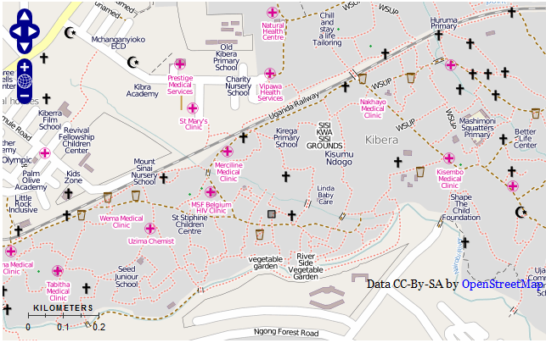
Map Kibera Project
Informal settlement in Nairobi, Kenya
Not on any map until Nov ‘09
Now a complete interactive community information project.

Slide 40



Tools for Data Quality
Mapdust
OSM Mapper from ItoWorld
MapCompare from GeoFabrik
OSM Inspector from GeoFabrik

Slide 41
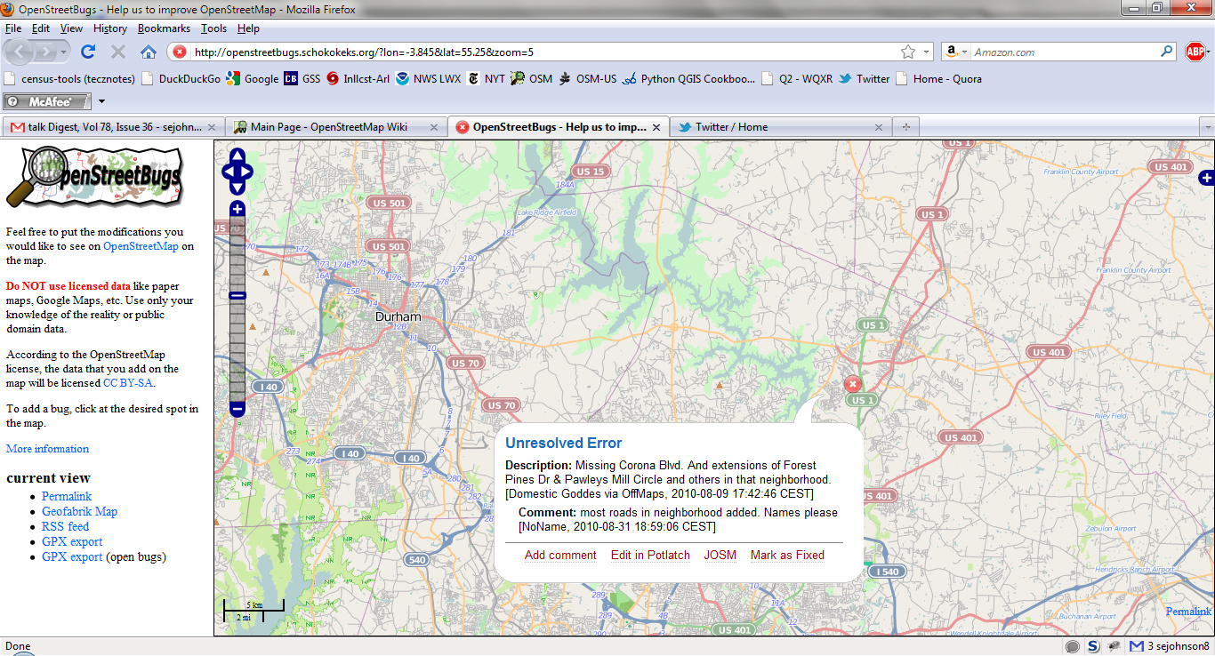
Tools: OpenStreetBugs

Slide 42

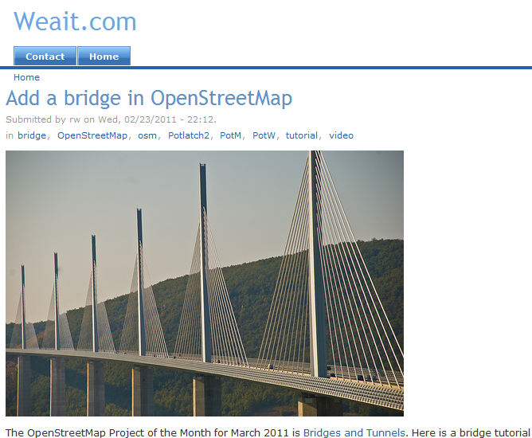
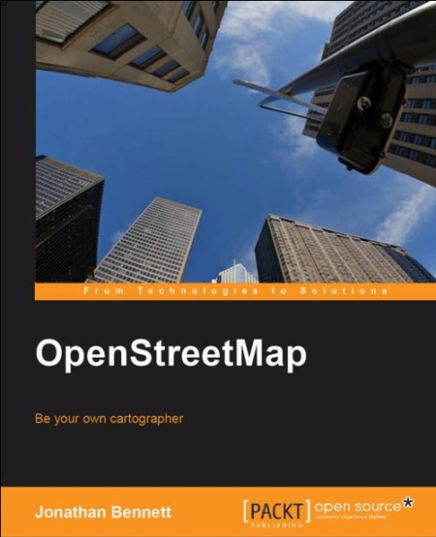
OSM Instructional Materials
Tutorials at Weait.com
Books by
Jonathan Bennett
Frederik Ramm, Jochen Topf, Steve Chilton

Slide 43








Commercial Adoption of OSM in 2012

Slide 44
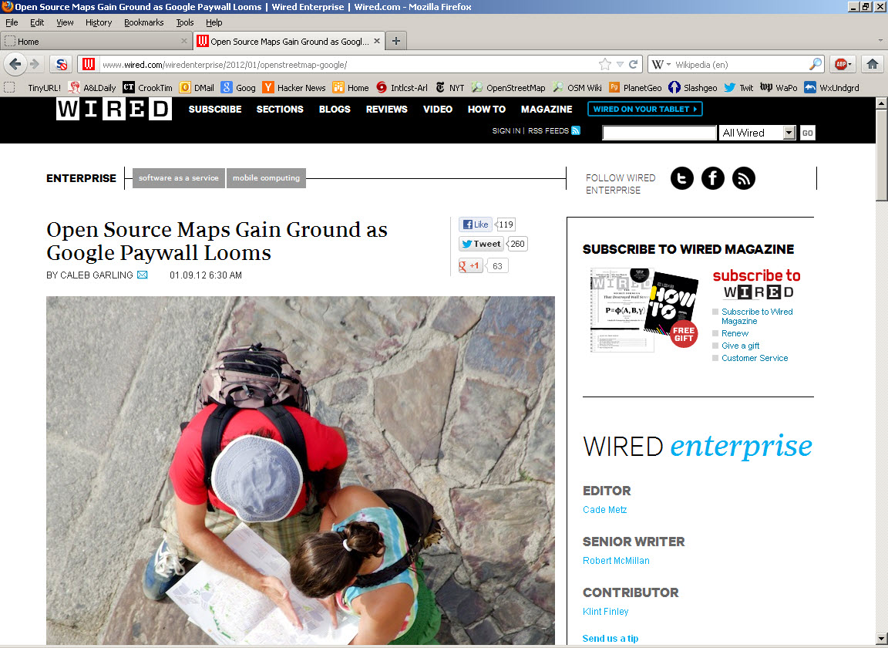
Press Attention to OSM

Slide 45
Summary: Why is OSM at a tipping point?
There are a growing number of services built around OpenStreetMap
Commercial
Non-governmental
Government
There are more utilities for data quality and data manipulation
Maturing community of users, resources, documentation
Growing Commercial Adoption

Slide 46
Why You Should Get Involved
(Hint: It has to do with community)

Slide 47
A Little Context…
The premise of Web 2.0 is that it breaks down the separation between content creators and content consumers.
Anyone can be a content creator now.
Barriers to participation that made sense in a pre-Web day no longer make sense.
Authority, accuracy, currency…change in with context

Slide 48
OSM is a classic Web 2.0 Application
OpenStreetMap, because it is web-based and open, provides a platform that benefits public institutions an rewards amateurs with meaningful geographic information.
Collaborative
Anyone can participate
Serious contributors develop authority through reputation

Slide 49
The Central Hypothesis
Encouraging a community of citizen scientists can yield benefits for the Census Bureau
More mappers engaging with their geography leads to…
…a community of citizen geographers, which leads to…
…a collective rise in the quality of broadly available geographic information

Slide 50
Motivations for participating
Individual
Forging bonds in the community
Satisfaction of seeing your work
Contributing to the knowledge commons
Utilitarian purposes
Institutional
Change detection
Locate the most current data
Find data not collected by other institutions, or agencies

Slide 51
Professional Expertise is needed
Worldwide, a big push to add and improve address data quality in OpenStreetMap
Improves routing capabilities
Improves coverage of landmarks and destinations
A North American Address schema is evolving
Draws on FGDC standard
Greater flexibility, adaptability for US contexts
Demonstrated success locally
MappingDC has imported data from District of Columbia
Includes building footprints and address data

Slide 52

Engage with Geography
This is your chance to play FR!
How do you deal with ambiguous addresses?
How do you tag mixed use buildings?
Challenges to your ability to describe real world features in geographic context

Slide 53
Summary
OpenStreetMap is at a tipping point
Growth of Community
Commercial Adoption
Community of Services built on OSM
Community engagement is vital
Mapping Parties
Citizen Science
How the Bureau can benefit from OSM
A platform for collaboration
Citizen engagement can augment Bureau’s reach
Extend Bureau capabilities for location information

Slide 54
Thank You
Questions?
Steven Johnson
(e) stevejohnson@deloitte.com
(t) @geomantic
This document licensed in entirety by Creative Commons CC-by-SA. For specific terms of license, see: http://creativecommons.org/licenses/by-sa/3.0/

